Slide 1

British Antarctic Survey An Introduction to High Performance Computing 2022

Slide 2

Introduction
HPC Technical Staff
Andrew England: HPC Service Owner
Paul Sumption: HPC Engineer
Jame Byrne: HPC Software / AI Lab

Slide 3

Your background
Programmers (or not).
Linux power users (or not).
Researchers wishing to run large, parallel code.
Researchers wishing to run many, non-parallel cases.
Researchers interested in big data, machine learning, AI.
Researchers requiring slightly more than an ordinary
Workstation. Many different disciplines and requirements!

Slide 4

Topics
Part 1: HPC basic principals
What is HPC?
Types of problems
Part 2: BAS HPC Resources
HPC Overview
Hardware
Storage
Part 3: Access
Authentication
SSH / X2go
Data transfer

Slide 5

Topics
Part 4: User Environment
Software
Modules
Shell
Part 5: SLURM
What is a scheduler
Basic SLURM commands
Part 6: Advanced
Containers
Part 7: Final tips
Best practise
Help
Links

Slide 6
Part 1: HPC Basic Principals

Slide 7

Part 1: What is HPC?
HPC: High Performance Computing
High powered workstation(s)
Lots of RAM
Lots of cores
High spec GPU cards for AI or 3D visualisation
Submit host for SLURM jobs
A compute cluster
A large number of computers (worker nodes) usually commodity servers
A head node(s)
Configured to work as one system and share resources
A scheduler (SLURM) runs and prioritises jobs
Nodes can pass messages between each other (parallelisation)
A National or TIER 1 centre
Dedicated data centres hosting large scale HPC clusters
Lots and lots of nodes!
Often used for scale out
JASMIN or ARCHER are facilities that you may have or need access to

Slide 8
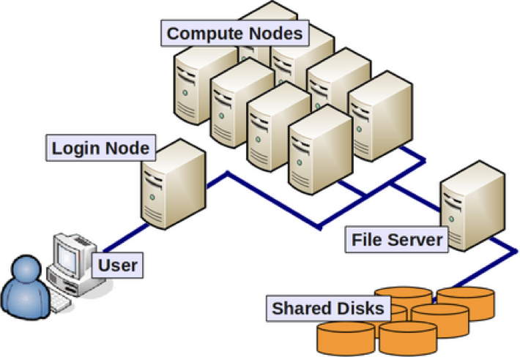
Part 1: A simple cluster
A cluster is a group of computers (worker nodes)
A head node co-ordinates resources: RAM, storage, cores, software
A login or submit node is used for sending jobs to the cluster
Normally there is some shared storage (group drives / homes)
Nodes might also have a small amount of local storage

Slide 9
Part 1: Why use HPC?
What types of big problem might require a “Big Computer”?
Memory Intensive: A single problem requiring a large amount of
memory.
Data Intensive: A single problem operating on a large amount of data.
High Throughput: Many unrelated problems to be executed in bulk
Compute Intensive: A single problem requiring a large amount of computation.

Slide 10

Part 1: Memory Intensive
A single problem that can requires a large amount of RAM
Memory requirements are greater than your laptop/desktop
Often a large amount of data needs to load into RAM before processing
Might not require multiple cores/CPU’s
Limited by maximum RAM in a workstation or node
Might consume a whole cluster node

Slide 11

Part 1: Compute Intensive
A single problem that can be split up across multiple CPUs to reduce the execution time as far as possible.
Program workload must be parallelised:
Parallel programs split into copies (processes or threads)
Each process/thread performs a part of the work on its own CPU, concurrently with the others
A well-parallelised program will fully exercise as many CPUs as there are processes/threads
The CPUs typically need to exchange information rapidly, requiring specialized communication hardware
This type of job is the traditional domain of HPC clusters

Slide 12
Part 1: Compute Intensive (Cont)
Parallelisation requires effort:
There are libraries to help (e.g. OpenMP, MPI)
OpenMP: parallelize in a shared memory system (whole node)
MPI: parallelize over a distributed system (multiple nodes)
MPI and OpenMP can be used at the same time in a hybrid job
Aim to make the the amount of code that can be parallelised and performance per CPU as large as possible
The scaling limit: eventually using more CPUs becomes detrimental instead of helpful.

Slide 13

Part 1: Data Intensive
Distributing a large data set for a single problem across multiple CPUs to reduce the overall execution time
The same work may be done on each data segment
Rapid movement of data to and from disk is the most important requirement
Flash or large amounts of storage are often required

Slide 14
Part 1: High Throughput
Distribute independent, multiple problems across many CPUs to reduce the overall execution time
Workload is trivially (or embarrassingly) parallel:
Workload breaks up naturally into independent pieces
Each piece is performed by a separate process/thread on a separate CPU (concurrently).
Little or no inter-CPU communication
Emphasis is on throughput over a period, rather than on performance on a single problem
A good example is running lots of the same R or python job, you are probably high throughput, and possibly data intensive or compute intensive as well

Slide 15
Part 1: Summary
Think about the type of problems you will need to solve
Learn how to run single core jobs first
If a job requires more cores than a single node you will need to look at panellisation
Open Source software will sometimes have an option to compile it to run in parallel (less work for you)
Otherwise you’ll need to start to write your own code (more work)
TensorFlow and Python both have good MPI support

Slide 16
Part 2: BAS HPC Facilities

Slide 17
Part 2: Hardware (workstations)
Gateway (Jump or Bastion) hosts (bslcenb & bslcenc)
Only use for access to BAS or transferring files, don’t use for running programs
General Use Workstations & Private Workstations
12 workstations
2 with GPU cards
Development Workstation
No access for normal users
Used by IT to test and build modules
Used by IT to test storage and other changes

Slide 18
Part 2: Hardware (Cluster)
Headnode(s)
No direct access, manages job queues and storage (/data/hpcdata)
CPU Nodes
20 CPU compute nodes
88 CPU cores+threads and 512GB system memory per node
GPU Nodes
Node021: 24 CPU cores (no threads), 512GB system memory and 2 x NVIDIA T4 GPU's each with 16GB GPU memory
Node022: 48 CPU cores+threads, 512GB System memory and 8 x NVIDIA V100S GPU's each with 32GB GPU memory
Only available for use BAS AI Lab members
Development Node
No access, used for testing by IT

Slide 19
Part 2: Storage (homes)
There are two home areas:
User Area - /users/<username>
Small, not intended for sharing data
Space restricted via quotas
Not accessible from the HPC Nodes!
HPC Storage - /data/hpcdata/users/<username>
Accessible from nodes and workstations
Space restricted via quotas

Slide 20
Part 2: Storage (group drives)
SAN Volumes
Setup for projects and departments, eg: /data/cruise, /data/vlf
Accessible from workstations, bslcenb, bslcenc
Volume should be managed and curated by a data manager
Space is not controlled by quota's
Adding additional space depends availability of physical disk space
Contact the data manager first if you think you require additional storage

Slide 21
Part 2: Storage policies
Quotas
On HPC you can check your quotas using: myquota
Make sure to check your storage quotas regularly
Jobs can fail if you are out of space
If you need more space then request it via the service desk
Backups
Daily at 6pm
All SAN and HPC volumes backed up
Backups are both onsite and offsite, via tapes disk
If you need a file restored, contact the service desk

Slide 22
Part 2: Fast Storage
HPC Storage - /data/hpcflash
Will be accessible from nodes and workstations, bslcenb, bslcenc
Currently only accessible from test nodes (work in progress)
For high throughput GPU and AI jobs
Access managed by the AI lab
Suitable for workflow that has fast I/O requirements

Slide 23
Part 3: Access

Slide 24
Part 3: Access
Authentication
Three passwords – UNIX (NIS), LDAP and Samba,
UNIX for bslcenb / bslcenc and LDAP for HPC workstations
Try to keep all these password synchronised
We are working to simplify the situation
Please make sure you have had an IT Induction (or arrange one via the service desk)
You will need all of the above passwords to complete the exercises

Slide 25
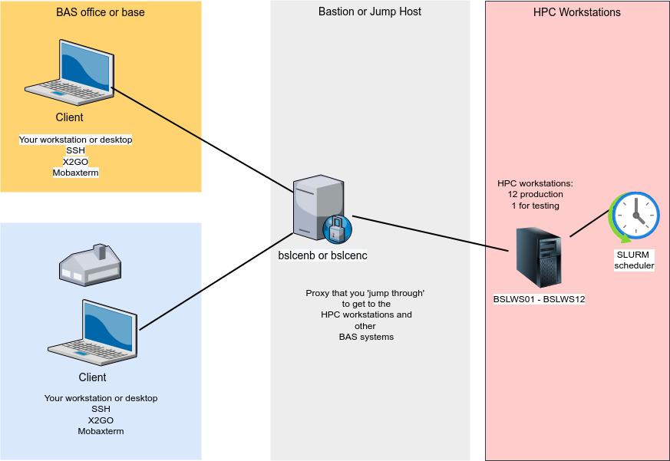
Part 3: Jump or Bastion hosts
To access HPC service(s) you need to pass through a bastion host(s)

Slide 26
Part 3: SSH
The Secure Shell Protocol (SSH)
BSLCNENB, BSLCENC and the HPC workstations allow you to connect using SSH
SSH is a cryptographic network protocol
It allows us to send data securely over public networks (internet)
Your data and commands are encrypted
You can authenticate using a password (if the server allows this)
You can authenticate using an SSH key
Your key needs to be in a format that the remote host understands
Older operating systems don’t always support the stronger key formats

Slide 27
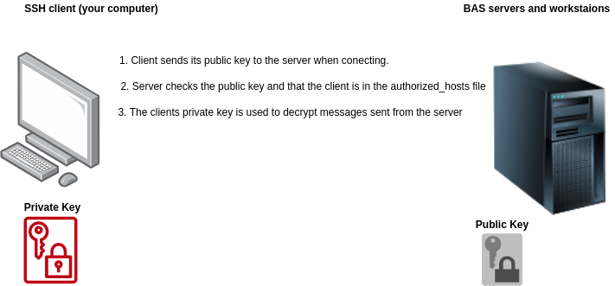
SSH Keys

Slide 28
Part 3: SSH into BAS systems
SSH
First connect to a gateway host(s): bslcenb.nerc-bas.ac.uk / bslcenc.nerc-bas.ac.uk
Second connect to HPC workstations: bslws01...bslws12
OpenSSH (available for Linux, Mac & windows), Putty, WSL, MobaXterm
Linux and Mac users can modify the file ~/.ssh/config then add aliases and jump hosts:
IdentityFile ~/.ssh/myusers_key Host bslcenc Hostname bslcenc.nerc-bas.ac.uk User pasump ## cluster via jump host as pasump ### Host bslws* Hostname %h User pasump ProxyCommand ssh -W %h:%p bslcenb
Demonstration of SSH

Slide 29
Generating an SSH key
To use an SSH key for accessing remote hosts:
You will need to generate an SSH key pair
You will need to transfer the public part of the key to the remote host you want to access: i.e.ssh-copy-id -i ~/.ssh/mykey user@host
Linux and Mac users: Your operating system includes the commands: ssh-keygen and ssh-copy-id
Windows users: Putty can generate keys
Best practise:
Make sure you keep the private part of the key safe!
Set a passphrase on your key!
Don’t store private keys in Onedrive or other cloud services
Follow the Service desk solution on how to generate keys: https://servicedesk.bas.ac.uk/app/itdesk/ui/solutions/60624000019410097/details

Slide 30
SSH Agent
SSH agent is part of Open SSH
ssh-agent is a key manager for SSH
It holds your keys and certificates in memory, unencrypted, and ready for use by ssh
It saves you from typing your passphrase every time you use your key
You are only prompted to type the passphrase once (unless you remove the key from the agent)

Slide 31
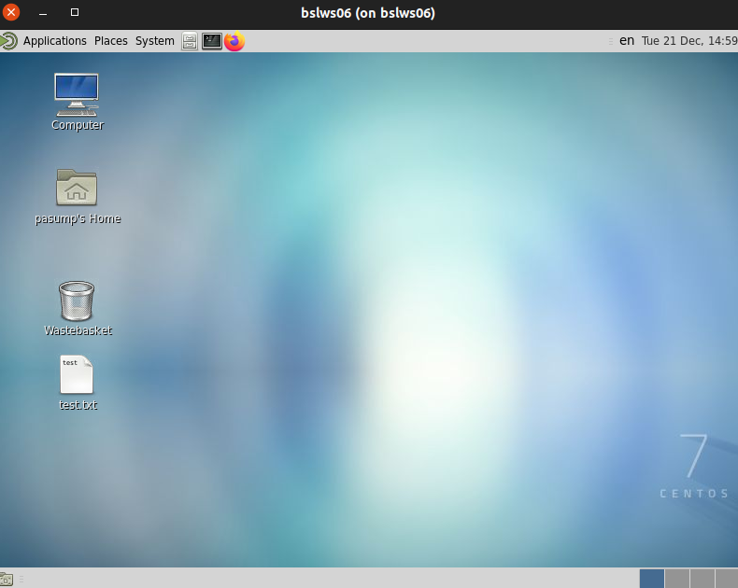
Part 3: X2GO
X2GO allows you to access a desktop environment for interactive work

Slide 32
Part 3: Access (X2GO continued)
X2Go
Access the HPC workstations desktop interface
Works with or without VPN access
Allows disconnecting and reconnecting to sessions
Copy/paste (remote to local and vice versa)
Sharing files from your laptop or PC
More information: http://ictdocs/wiki/index.php/HPC:X2GO
Demonstration of X2GO
Service Desk Solution:
Setting up X2go on Linux, Windows or Mac:https://servicedesk.bas.ac.uk/app/itdesk/ui/solutions/60624000019605299/details

Slide 33
Part 3: Access (continued)
X2Go alternatives (for Windows users)
putty, pscp, psftp: http://www.chiark.greenend.org.uk/~sgtatham/putty/download.html
Good if you are mainly using SSH and terminals/command line
WinSCP: http://winscp.net/eng/download.php
Cygwin (provides an application environment similar to Linux): http://cygwin.com/install.html
Includes X server for displaying graphical applications running remotely
MobaXterm: http://mobaxterm.mobatek.net/
Probably the best alternative to X2GO

Slide 34
Part 3: Access (Mac / Linux)
Both Mac (OS X) and Linux have:
Terminal applications installed as part of the OS
Common UNIX commands such as: cp, mv, ls, ssh, scp, sftp, rsync
If you requite a GUI for using FTP:
GFTP: Installed from most Linux package managers
Cyberduck: for OS X https://cyberduck.io/
I would also recommend installing and learning a good text editor (useful when working on remote scripts or JASMIN/ARCHER)
Vi and vim are both powerful editors (but take some learning!)

Slide 35
Part 3: Data Access and Transfer
Samba
Allows clients to connect to BAS UNIX storage servers as if they were a windows network share
Allows access to SAN volumes, /users and /data/hpcdata
There is no SAMBA access to /data/hpcflash
It's advisable to set up SAMBA with the same password as that which you use for Windows
There is a service desk solution for this: https://servicedesk.bas.ac.uk/app/itdesk/ui/solutions/60624000016015047/details

Slide 36
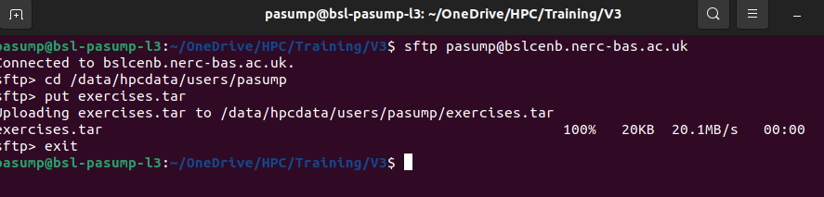
Part 3: Data Access and Transfer
SFTP
Secure File Transfer Protocol (FTP over SSH)
Can be used with a GUI or command line
The SAN volumes, /users and /data/hpcdata can be accessed from bslcenb.nerc-bas.ac.uk and bslcenc.nerc-bas.ac.uk
You can use SFTP to connect to one of these hosts and transfer files in/out

Slide 37
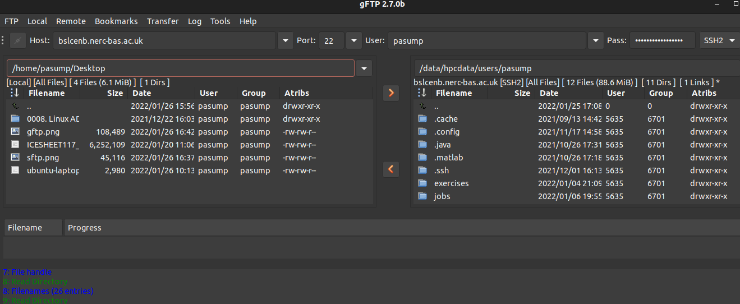
Part 3: Data Access and Transfer
SFTP
File transfer using a graphical client: files can be dragged from one host to another.

Slide 38

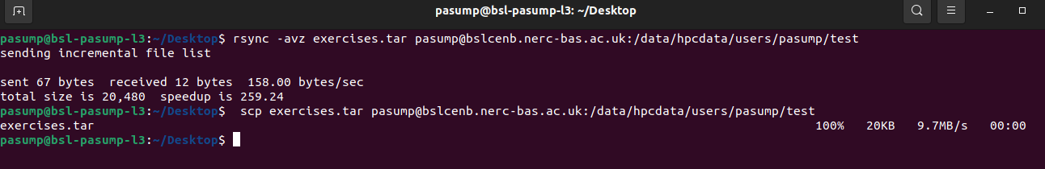
Part 3: Data Access and Transfer (Cont.)
SCP
Secure Copy, good for transferring single files
Works over SSH
rsync
Perfect tool for transferring files locally and securely over the internet
Options to resume, reconnect, compress data and limit transfer rates
Works over SSH

Slide 39
Part 3: Data Access and Transfer (Cont.)
sshfs
Allows a filesystem to be mounted over SSH
Doesn’t deal with file locking!
Access can be quite slow
Summary
However you transfer files you should use a secure protocol!
Be careful with the / in your rsync commands see: http://qdosmsq.dunbar-it.co.uk/blog/2013/02/rsync-to-slash-or-not-to-slash/

Slide 40
Part 4: User Environment

Slide 41
Part 4: User Environment
The Linux Shell
The shell is the Linux command line interpreter
It is the interface between the user and the operating system (kernel) and executes programs that we refer to as commands
Our default shell is tcsh
If you prefer something different such as bash, contact the service desk
To check which shell you are using type: echo "$SHELL"
If you raise an service desk ticket it is helpful to include details such as which shell you are using

Slide 42
Part 4: User Environment
Shell Scripts
A shell script is a file containing code that is interpreted by your shell (sometimes called a bash or tcsh script).
Shell scripts are useful for cleaning up data and performing small functions
It is worth investing some time in learning some basic shell scripting
You can run a shell script you have written as part of your HPC job
Example:
A repeated tasks is to replace some text in the file ‘input.txt’. Rather than type the command each time we write a bash script: replace.sh to do this #!/bin/bash sed -i 's/old-text/new-text/g' input.txt

Slide 43
Part 4: User Environment
Tmux
Keeps long running command line sessions running
Allows disconnecting and reconnecting
Multiple command line sessions and console splitting
More information: http://ictdocs/wiki/index.php/tmux

Slide 44
Part 4: Software
Operating System software
The operating system install (nodes and workstations) is just the base packages
This includes some graphical packages (accessible from the menus when connected via X2GO)
Linux commands such as cp, mv, scp, rsync etc
The software can be be run from the command line and desktop interface
The core system is kept in a ‘vanilla’ state to stop packages that might conflict causing problems

Slide 45
Part 4: Software
Modules
The purpose of the modules system is to allow us to load a software that is not part of our base OS i.e. a different version of Python
The modules system is not installed on and will not work on bslcenb or bslcenc
There are two module repositories: /packages/modules & /hpcpackages/modules
/hpcpackages/modules - works with nodes and workstations
Modules sometimes include the compiler used in their name eg. hpc/netcdf/intel/4.4.1.1
Works by adjusting shell variables eg. PATH, LD_LIBRARY_PATH
Loaded modules only affect the terminal (or SLURM job) you load them in

Slide 46
Part 4: Software (continued)
Modules
Useful module commands:
module avail module display name/version
module load name/version module list
module unload name/version module purge
Common mistakes
Forgetting to use hpc modules on nodes
Mixing modules created using different compilers
Loading clashing modules
More information: http://ictdocs/wiki/index.php?title=HPC:User_Guide
Demonstration of the module system

Slide 47
Part 4: Jupyter Notebooks
Jupter notebooks running on workstations: http://jupyterhub.nerc-bas.ac.uk
More information: http://ictdocs/wiki/index.php/HPC:JupyterHub

Slide 48
Part 5: SLURM

Slide 49
Part 5: SLURM
What is it?
Simple Linux Utility for Resource Management:
It manages jobs submitted to the cluster
It determines which HPC resources you can access
It applies limits such as:
Maximum job run time (wall time)
How many cores you can use
How much RAM you can use
The scheduler looks at a job script and then prioritises them based on:
Resources required
Resources available
Backfill and fair share take care of slotting jobs into the queue
Cancelling and resubmitting jobs won’t help move them through the queue!

Slide 50
Part 5: SLURM
Different queues
Short queue (nodes 2 to 4)
Maximum run time of 30 minutes
Intended for short jobs and debugging which complete quickly
Medium (nodes 12 to 17)
Maximum run time of 48 hours
Intended for large MPI jobs
Long (nodes 17 to 20)
Maximum run time of 2 weeks
Intended for long running jobs
GPU
node021: 2 x NVIDIA T4 GPU's each with 16GB GPU memory
Node022: 512GB System memory and 8 x NVIDIA V100S GPU's each with 32GB GPU memory

Slide 51
Part 5: Fair Share
Fair Share
Ensures each user gets fair usage of each HPC queue
A user that has run a lot jobs will get a lower priority than a user than has run none
Adjusts priorities of submitted jobs based on previous usage
Fair share is applied to all submitted jobs
The HPC user guide has some example job scenarios with explanations of how fair share would be applied See: http://ictdocs.nerc-bas.ac.uk/wiki/index.php/HPC:User_Guide#SLURM_Fair_Usage_Scheduler

Slide 52
Part 5: SLURM
Job Types
Jobs may be either non-interactive (batch) or interactive:
Batch jobs run a shell script on the first of a list of allocated nodes
The user submits a job script into a queue
The job runs when resources are available (user has no interaction)
Interactive jobs provide a command line on the first of a list of allocated nodes.
The user requests a node or nodes: sintr -A short -N1 -n8 -t 1:0:0
You load modules and type commands on the allocated node(s)
Good if you have to write a complex SLURM job scripts (test on one node!)

Slide 53
Part 5: SLURM
Job Types (cont.)
MPI
Good for compute intensive jobs with a related workflow
Jobs that require more cpu cores or RAM than a single node
MPI has a dedicated infiniband network messaging
All nodes need to be in the same queue.
Array: http : //slurm.schedmd.com/job array .html
Used for submitting and managing large sets of similar jobs
Maximum of 1000 jobs
Each job in the array has the same initial options
GPU - To use GPU's you must include the –gres option with the number of GPU's you require:
#SBATCH --gres=gpu:2

Slide 54
Part 5: SLURM
Job submission scripts – example:
#!/bin/bash #SBATCH –output=/data/hpcdata/users/pasump/jobs/matlab.%j.%N.out #SBATCH –error=/data/hpcdata/users/pasump/jobs/matlab.%j.%N.err #SBATCH -J matlab#SBATCH –mem=4gb #SBATCH –time=00:10:00 #SBATCH –mail-type=begin,end,fail,requeue #SBATCH --mail-user=pasump@bas.ac.uk #SBATCH –partition=short #SBATCH --account=short source /etc/profile.d/modules.sh
module purge module load hpc/matlab/R2021a
SCRIPTNAME=/data/hpcdata/users/pasump/jobs/matlabplot.m
matlab -nodesktop -nosplash -nodisplay -r "try run('${SCRIPTNAME}'); catch exit; end; exit"

Slide 55
Part 5: SLURM
Job submission scripts – example:
- Each of the #SBATCH directives are interpreted by SLURM to setup your job
- In my example I set:
1. A job error and job ouput file. %j appends the job number to the files, %N the nodename. 2. -J sets my jobname, I will see this when I check the queue 3. --mem sets the amount of RAM I require per core 4. --time sets the maxmimum runtime of my job, the format is days, hours and minutes 5. --mail we set when SLURM should email us, in my example I ask to for an email when my job starts, ends, fails or gets requeued* 6. --mail-user this should be your @bas email address. 7. --partition My job only needs 10 mins so I an using the short run partition 8 --acount The account needs to have access to the partion, in our case the name matches the partition (short for short, medium or medium etc) 9. The source command sets up our module environment by reading a file that contains some settings 10. To be sure we are running in a clean environment we purge any loaded modules 11. We then add any module load commands for modules we want our job to load 12. The have user a variable SCRIPTNAME to set the full path to my matlab script 13. The final line is the program we wish to run and some options we wish to send to it such as the matlab scriptname an exit command.
*re-queing can cause problems such as data being overwritten.
Useful Options
Exclusive node: #SBATCH –exclusive Specific node: #SBATCH --nodelist=node022

Slide 56
Part 5: SLURM (continued)
ueue
Job monitoring
squeue -u <username>
sacct -j <jobid>
To see details on resources used by all running jobs: scontrol show jobid –dd <jobid>
To see all your recent jobs: sacct -u <username>
To check memory and cpu usage on a node: scontrol show node <node>
See the service desk solution on SLURM commands (queues and jobs) https://servicedesk.bas.ac.uk/app/itdesk/ui/solutions/60624000019535035/details

Slide 57
Part 5: SLURM (continued)
Troubleshooting failed jobs
Set an output file, often has useful information when jobs fail
Common mistakes
Forgetting to load modules
Using storage which is not visible to the HPC nodes (use either /data/hpcdata or /data/hpcflash)
Avoid using symlinks
Did you load any require modules
Check your quota
More information: http://ictdocs/wiki/index.php?title=HPC:User_Guide
Demonstration: single core SLURM job

Slide 58
Part 6: Advanced

Slide 59
Part 6: Containers
Containers at BAS are still a work in progress
What are containers?
Podman
To be able to use, you need to contact the service desk
Container images must be downloaded to each node or workstation
Singularity
Designed with HPC usage in mind
Ready to use on workstations and nodes
For more information: http://ictdocs/wiki/index.php/HPC:Containers

Slide 60
Part 7: Final tips

Slide 61
Developer Environment
Use git!
If you are writing code it is a good idea to put it onto github
You can git pull the code onto remote machines (and reverse changes)
Try to make your code:
Repeatable: can another lab member download and run your code?
Reproducible: could some else repeat your workflow?
Shareable: put your code in a group drive or repository such as github
If you need to move work between clusters containers can help. All of the required software is within the container.

Slide 62
Best Practice
User Policy
Link:
Do!
Test small jobs first (one core) before submitting a large array
Ask for help:
Preferably submit a help desk ticket
Give us much detail as possible
Don't!
Submit jobs which use more than 4 nodes at a time
Cancel and reschedule jobs
Request more RAM/Cores than you need

Slide 63
HELP!
Service desk: servicedesk@bas.ac.uk
Send in a ticket if you are having problems
Try to give some detail of the problem
For HPC jobs the name/location of your job script, what shell you are using, modules you are trying to use
HPC User Guide: http://ictdocs/wiki/index.php?title=HPC:User_Guide
Service Desk Solutions
Short solutions to common problems i.e. generating an SSH key
Email List: bashpc@exchange.nerc.ac.uk
You get added to this list when we create your account

Slide 64
Any Questions?

